Slide 1
Fitting Neural Networks

Slide 2
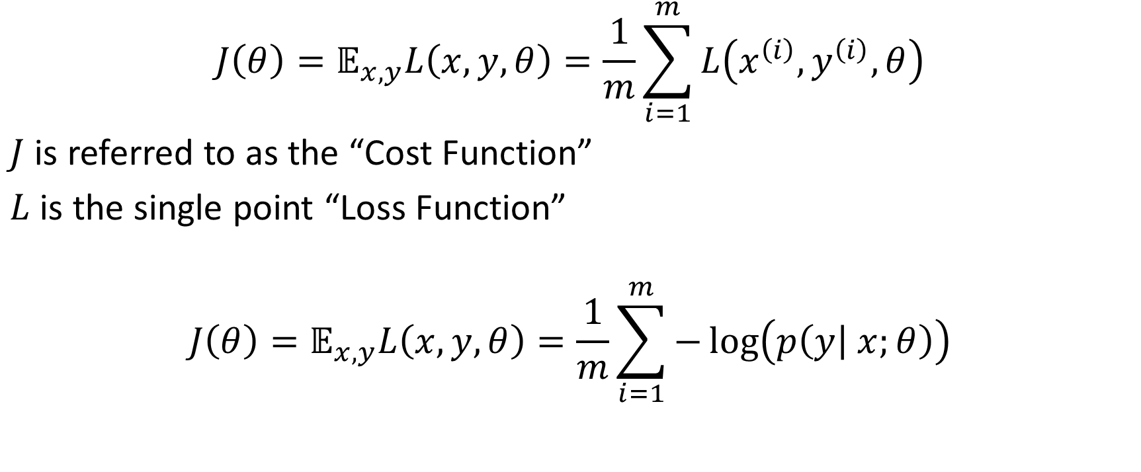
Cost Function
$$J\left(θ\right)=𝔼_{x,y}L\left(x, y, θ\right)=\frac{1}{m}\sum_{i=1}^{m}{L\left(x^{\left(i\right)}, y^{\left(i\right)}, θ\right)}$$
$J$ is referred to as the “Cost Function”
$L$ is the single point “Loss Function”
$$J\left(θ\right)=𝔼_{x,y}L\left(x, y, θ\right)=\frac{1}{m}\sum_{i=1}^{m}{−\log\left(p\left(y | x;θ\right)\right)}$$
Notes:
In practice L can be any number of things

Slide 3
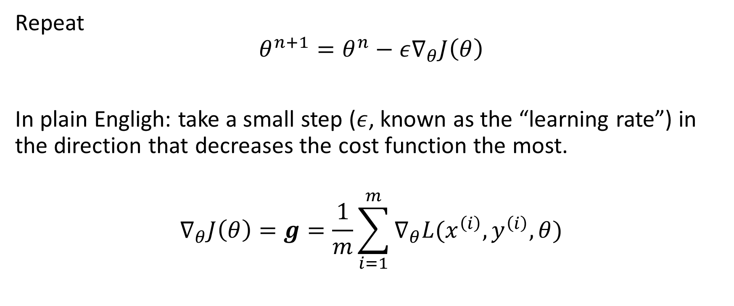
Stochastic Gradient Descent Algorithm
Repeat
$$θ^{n+1}=θ^{n}−ε∇_{θ}J\left(θ\right)$$
In plain Engligh: take a small step ($ε$, known as the “learning rate”) in the direction that decreases the cost function the most.
$$∇_{θ}J\left(θ\right)=g=\frac{1}{m}\sum_{i=1}^{m}{∇_{θ}L(x^{\left(i\right)},y^{\left(i\right)}, θ)}$$

Slide 4
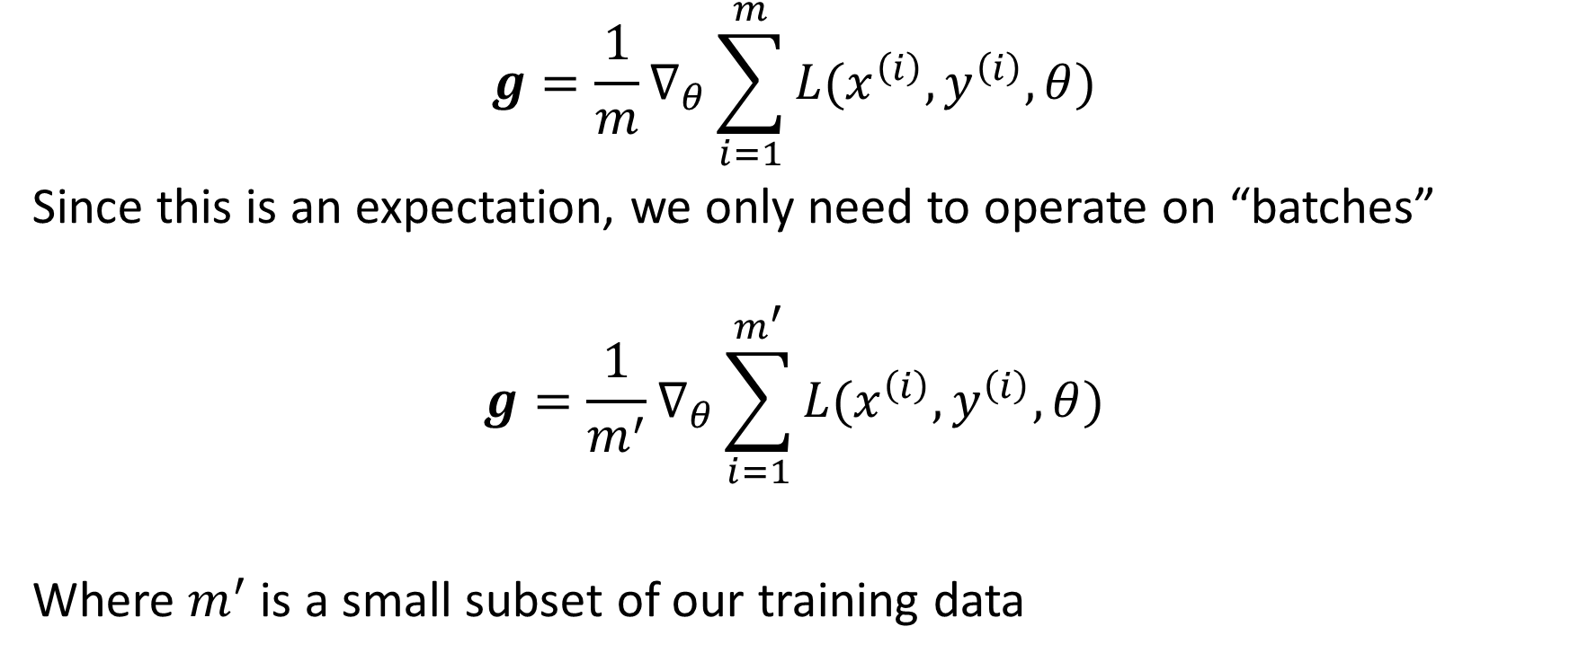
Stochastic Gradient Descent Algorithm
$$g=\frac{1}{m}∇_{θ}\sum_{i=1}^{m}{L(x^{\left(i\right)},y^{\left(i\right)}, θ)}$$
Since this is an expectation, we only need to operate on “batches”
$$g=\frac{1}{m^{′}}∇_{θ}\sum_{i=1}^{m^{′}}{L(x^{\left(i\right)},y^{\left(i\right)}, θ)}$$
Where $m^{′}$ is a small subset of our training data

Slide 5
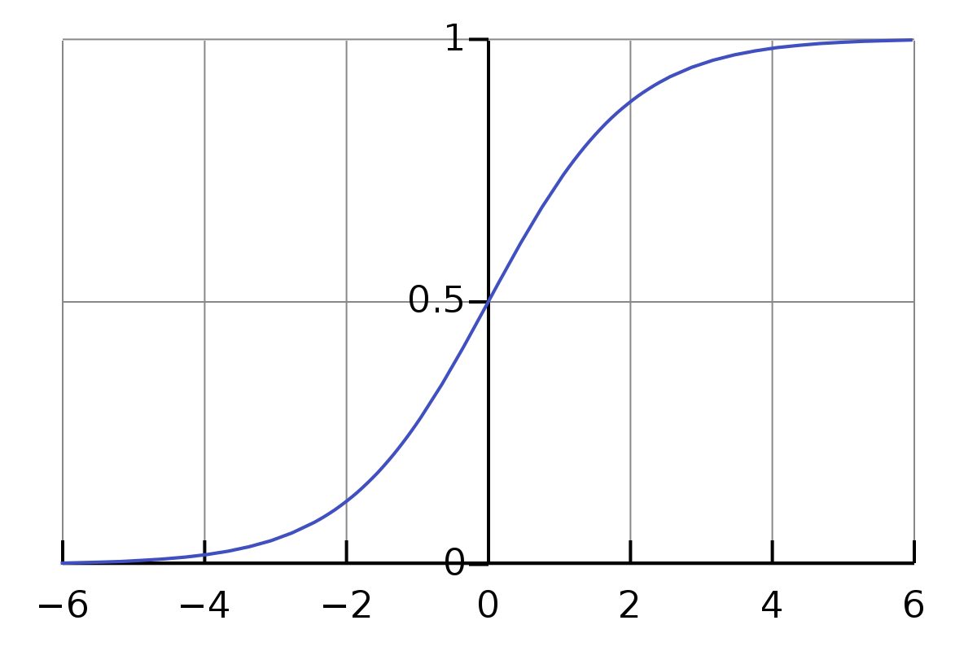
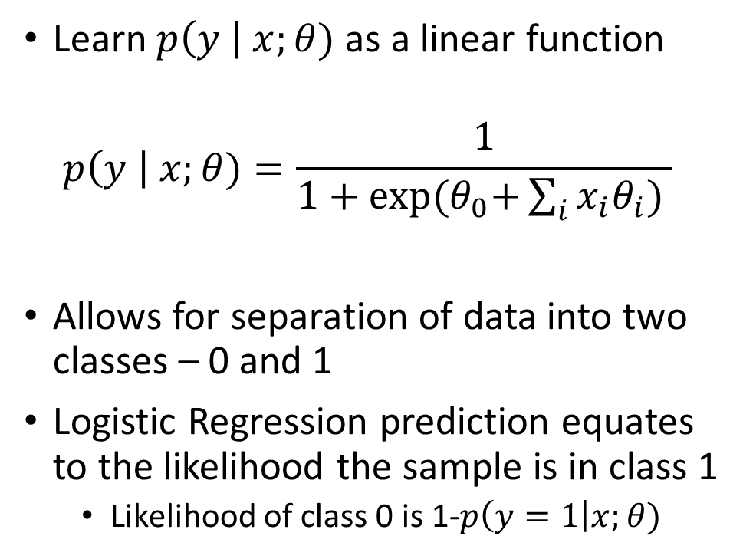
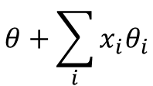
Example: Logistic Regression
Learn $p\left(y \right| x;θ)$ as a linear function
$$p\left(y \right| x;θ)=\frac{1}{1+\exp{{(θ}_{0}+\sum_{i}{x_{i}θ_{i}}) }}$$
Allows for separation of data into two classes – 0 and 1
Logistic Regression prediction equates to the likelihood the sample is in class 1
Likelihood of class 0 is 1-$p\left(y=1\right|x;θ)$
$$θ+\sum_{i}{x_{i}θ_{i}}$$

Slide 6
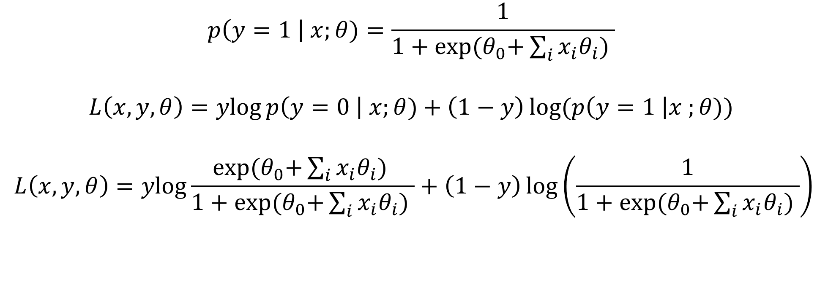
Logistic Regression
$$p\left(y=1 \right| x;θ)=\frac{1}{1+\exp{{(θ}_{0}+\sum_{i}{x_{i}θ_{i}}) }}$$
$$L\left(x, y, θ\right)=\operatorname{ylog}{p\left(y=0 \right| x;θ)+\left(1−y\right)\log{(p\left(y=1 \right|x ;θ)) }}$$
$$L\left(x, y, θ\right)=\operatorname{ylog}{\frac{\exp{{(θ}_{0}+\sum_{i}{x_{i}θ_{i}}) }}{1+\exp{{(θ}_{0}+\sum_{i}{x_{i}θ_{i}}) }}+\left(1−y\right)\log\left(\frac{1}{1+\exp{{(θ}_{0}+\sum_{i}{x_{i}θ_{i}}) }}\right)}$$

Slide 7
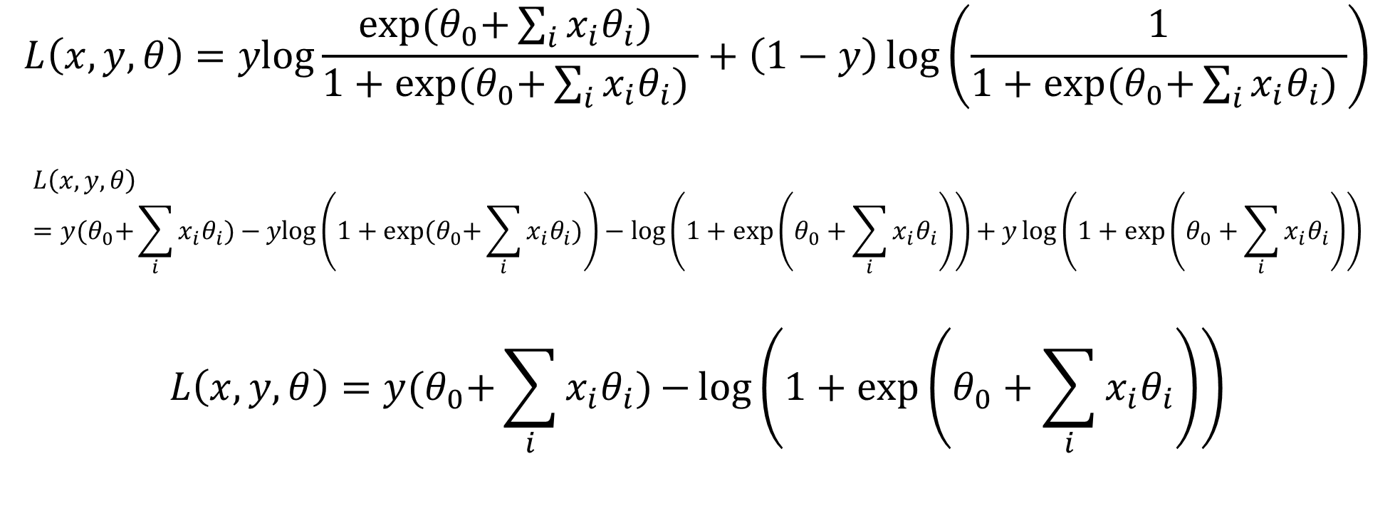
Logistic Regression
$$L\left(x, y, θ\right)=\operatorname{ylog}{\frac{\exp{{(θ}_{0}+\sum_{i}{x_{i}θ_{i}}) }}{1+\exp{{(θ}_{0}+\sum_{i}{x_{i}θ_{i}}) }}+\left(1−y\right)\log\left(\frac{1}{1+\exp{{(θ}_{0}+\sum_{i}{x_{i}θ_{i}}) }}\right)}$$
$$L\left(x, y, θ\right)=y{(θ}_{0}+\sum_{i}{x_{i}θ_{i}})−ylog\left(1+\exp{{(θ}_{0}+\sum_{i}{x_{i}θ_{i}})}\right)−\log\left(1+\exp\left(θ_{0}+\sum_{i}{x_{i}θ_{i}}\right)\right)+y\log\left(1+\exp\left(θ_{0}+\sum_{i}{x_{i}θ_{i}}\right)\right)$$
$$L\left(x, y, θ\right)=y{(θ}_{0}+\sum_{i}{x_{i}θ_{i}}){−\log\left(1+\exp\left(θ_{0}+\sum_{i}{x_{i}θ_{i}}\right)\right)}$$

Slide 8
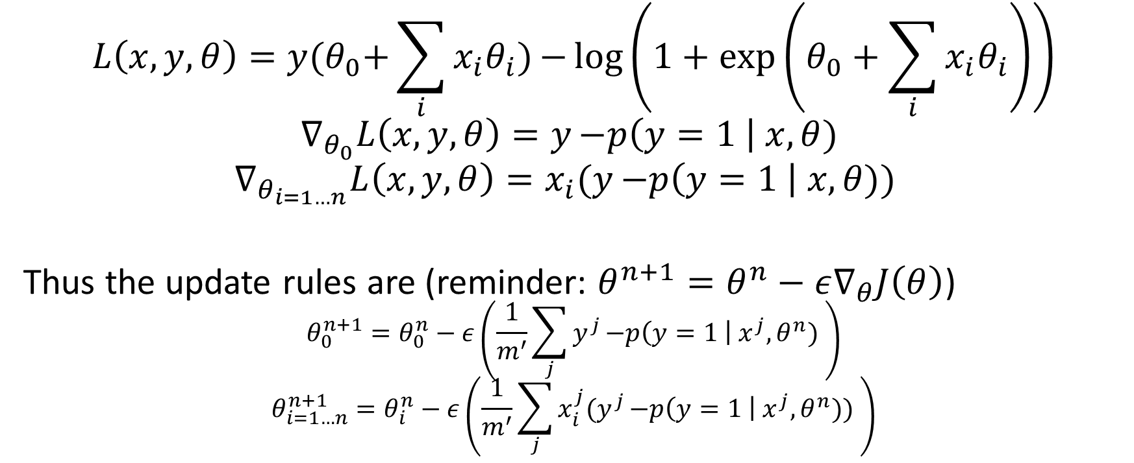
Logistic Regression
$$L\left(x, y, θ\right)=y{(θ}_{0}+\sum_{i}{x_{i}θ_{i}}){−\log\left(1+\exp\left(θ_{0}+\sum_{i}{x_{i}θ_{i}}\right)\right)}$$
$$∇_{θ_{0}}L\left(x, y, θ\right)=y{−p\left(y=1 \right| x, θ) }$$
$$∇_{θ_{i=1…n}}L\left(x, y, θ\right)=x_{i}(y{−p\left(y=1 \right| x, θ)) }$$
Thus the update rules are (reminder: $θ^{n+1}=θ^{n}−ε∇_{θ}J\left(θ\right)$)
$$θ_{0}^{n+1}=θ_{0}^{n}−ε\left(\frac{1}{m^{′}}\sum_{j}{y^{j}{−p\left(y=1 \right| x^{j}, θ^{n}) }}\right)$$
$$θ_{i=1…n}^{n+1}=θ_{i}^{n}−ε\left(\frac{1}{m^{′}}\sum_{j}{x_{i}^{j}(y^{j}{−p\left(y=1 \right| x^{j}, θ^{n})) }}\right)$$

Slide 9
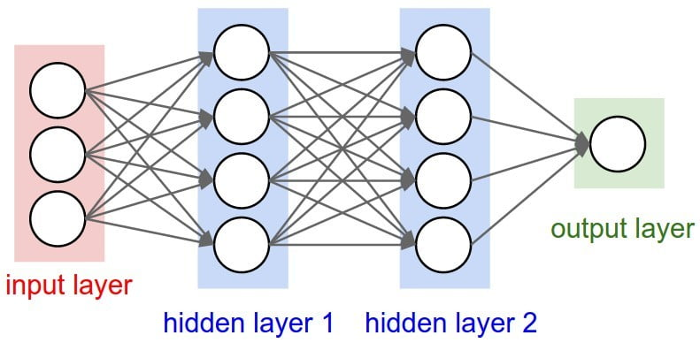
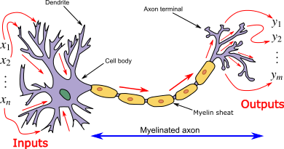
Neural Networks

Slide 10
Perceptron
Similar to logistic regression
Neural network with only an output layer and no hidden layers

Slide 11
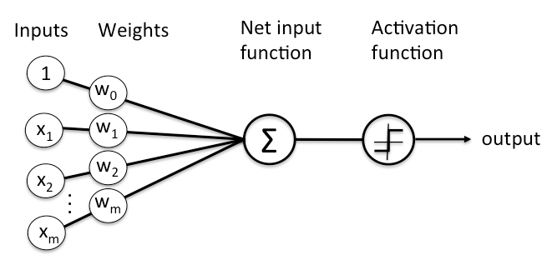
Neurons and activation functions

Slide 12
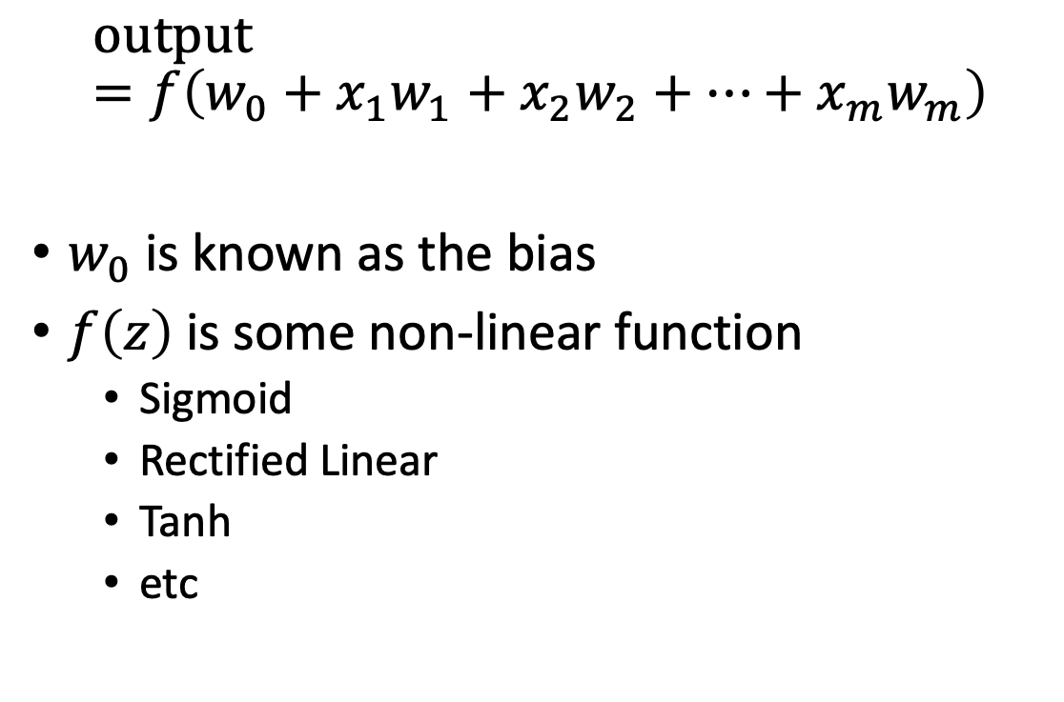
Neurons and Activation Functions
$$o\text{utput}=f\left(w_{0}+x_{1}w_{1}+x_{2}w_{2}+…+x_{m}w_{m}\right)$$
$w_{0}$ is known as the bias
$f\left(z\right)$ is some non-linear function
Sigmoid
Rectified Linear
Tanh
etc

Slide 13
Layer of a Network
Consists of weights and biases, representing a transformation
Two hidden layers in this example
Hidden typically means not shown in any output

Slide 14
Neural Network Architectures
Number of layers
2 to hundreds
Types of activation functions
Sigmoid, ReLU, Tanh, PReLU, ELU, etc
Structure of the layers
Fully connected, locally connected, convolutional
Loss Function
Cross-Entropy, Mean Absolute Error, Mean Squared Error

Slide 15
Feedforward Neural Networks
Inputs are entered into the network, causing the first hidden layer to activate
Then, the first hidden layer causes the second to activate, then the third, etc
Finally, the output layer
https://gfycat.com/deadlydeafeningatlanticblackgoby-three-blue-one-brown-machines-learning

Slide 16
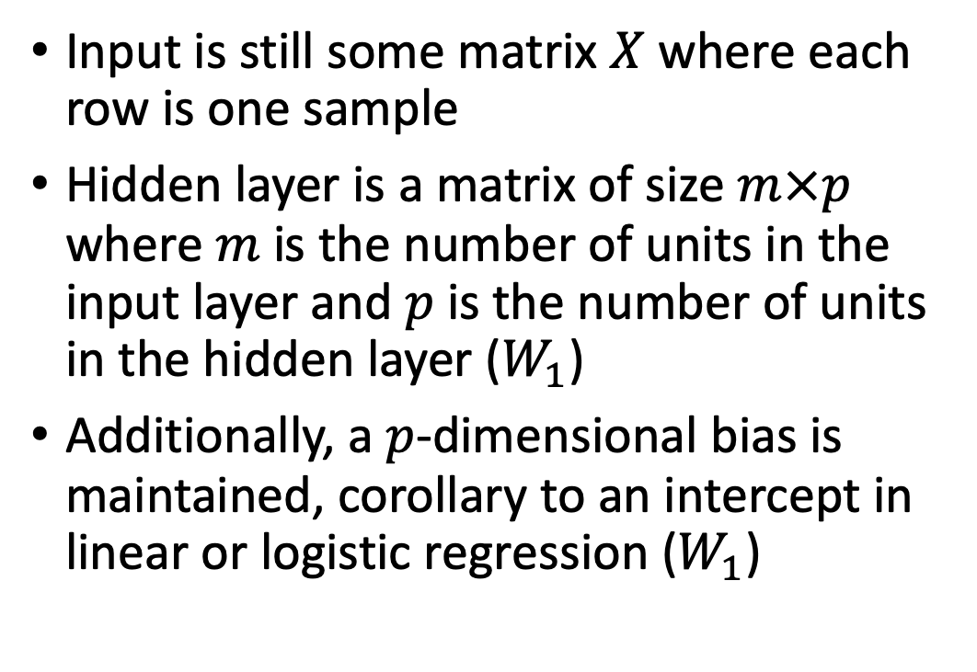
Feedforward Step
Input is still some matrix $X$ where each row is one sample
Hidden layer is a matrix of size $m×p$ where $m$ is the number of units in the input layer and $p$ is the number of units in the hidden layer ($W_{1}$)
Additionally, a $p$-dimensional bias is maintained, corollary to an intercept in linear or logistic regression ($W_{1}$)

Slide 17
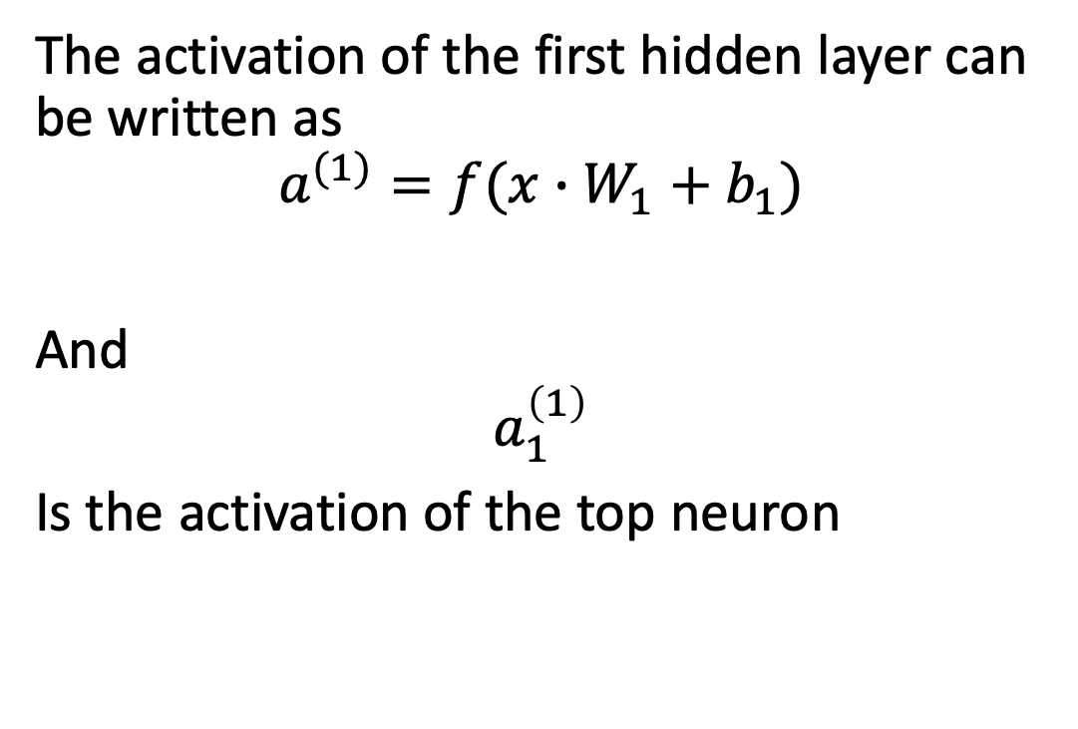
Feedforward Step
The activation of the first hidden layer can be written as
$$a^{(1)}=f(x∙W_{1}+b_{1})$$
And
$$a_{1}^{\left(1\right)}$$
Is the activation of the top neuron

Slide 18
Backpropogation Algorithm
Application of the chain rule to training neural networks
Use stochastic gradient descent to calculate the error with respect to the previous layer, sum up the changes and repeat

